Slide 1
Introduction to Quantum Computing: From a Layperson to a Programmer in 30 Steps
Hiu-Yung Wong
https://link.springer.com/book/10.1007/978-3-030-98339-0
https://www.amazon.com/Introduction-Quantum-Computing-Layperson-Programmer/dp/3030983382
Playlist: https://www.youtube.com/watch?v=qyPo6u3nJik&list=PLnK6MrIqGXsJfcBdppW3CKJ858zR8P4eP&index=53
https://www.youtube.com/watch?v=dLSDYTP4QSs&list=PLnK6MrIqGXsJfcBdppW3CKJ858zR8P4eP&index=54
https://www.youtube.com/watch?v=z3dRDOalBxs&list=PLnK6MrIqGXsJfcBdppW3CKJ858zR8P4eP&index=57

Slide 2
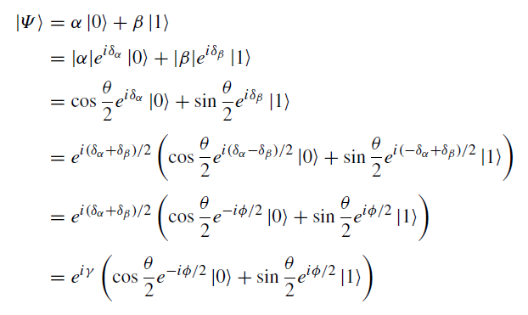

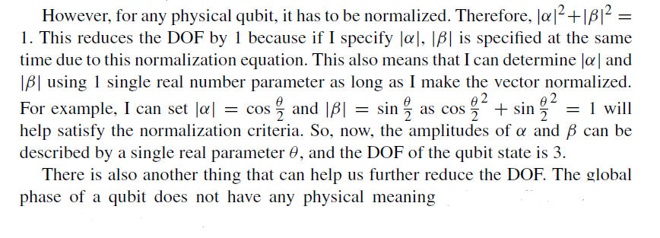
Bloch Sphere
A convenient way to represent qubit in real 3D space
2D complex vector space mapped to 3D unit vector space
Degrees of Freedom: DOF = ?

Slide 3
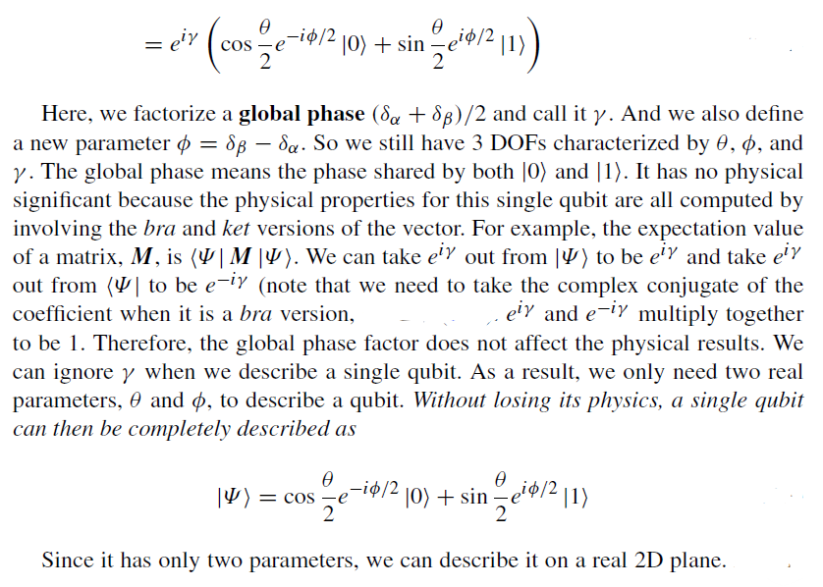

Slide 4
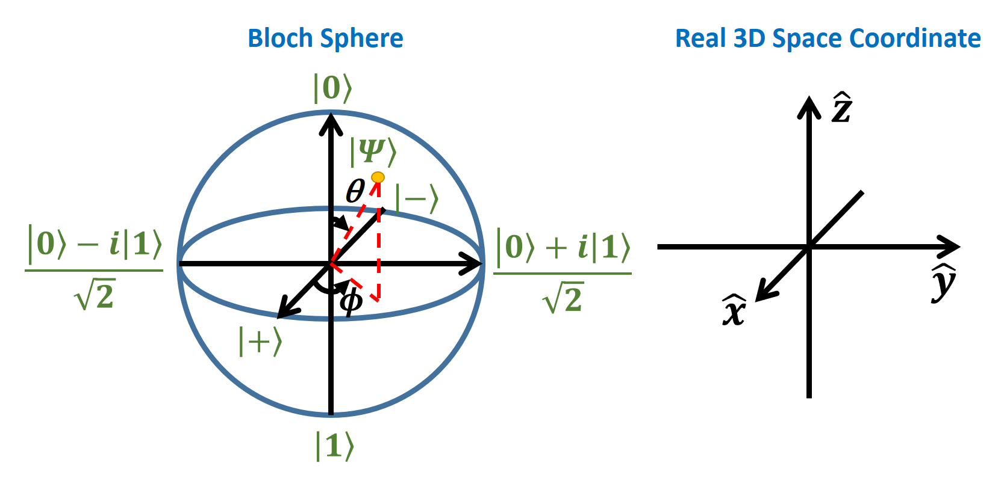
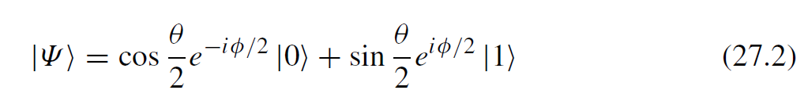
Embedding C² space in 3D space

Slide 5

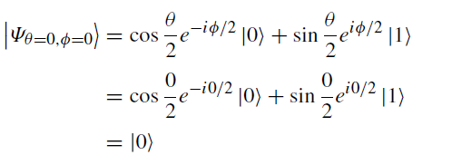
Extrema in Bloch Sphere

Slide 6
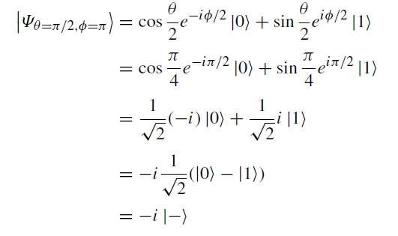
Extrema in Bloch Sphere

Slide 7
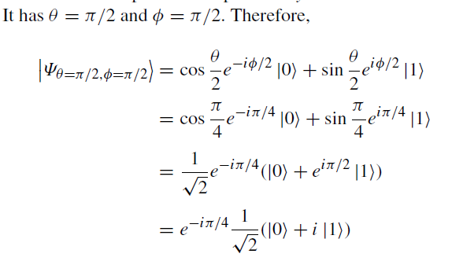
Extrema in Bloch Sphere

Slide 8
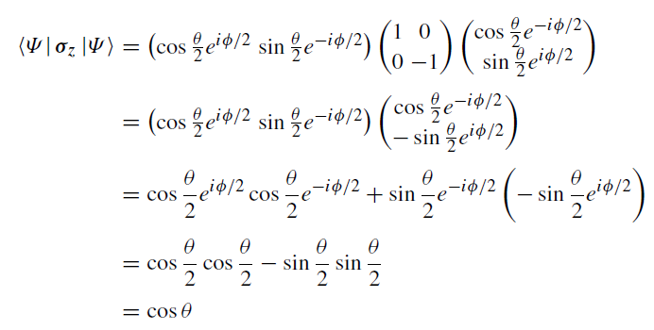
Expectation Values for Pauli Matrices

Slide 9
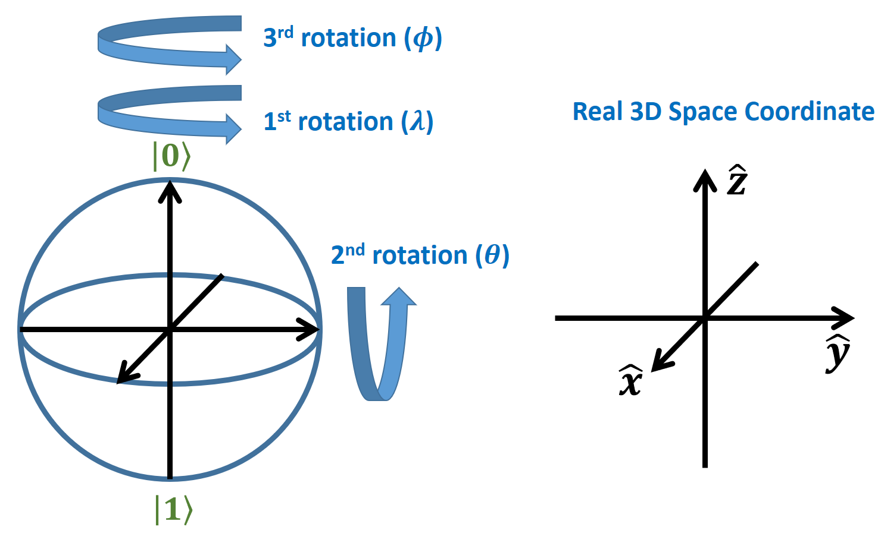

Rotation on Bloch Sphere (2nd reason to use the Bloch Sphere)

Slide 10
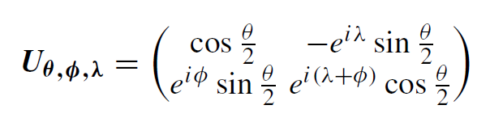
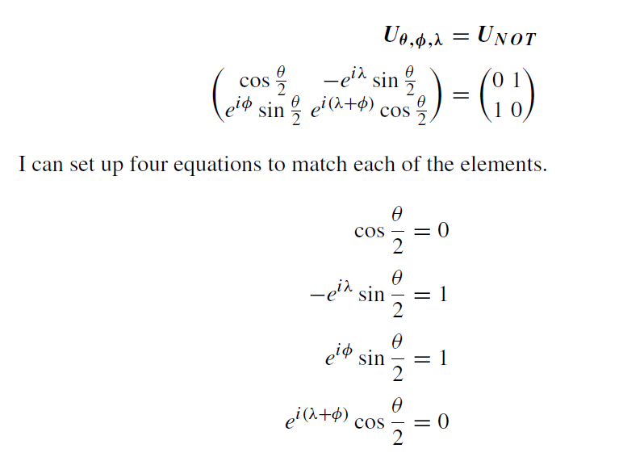
Construct a NOT Gate

Slide 11
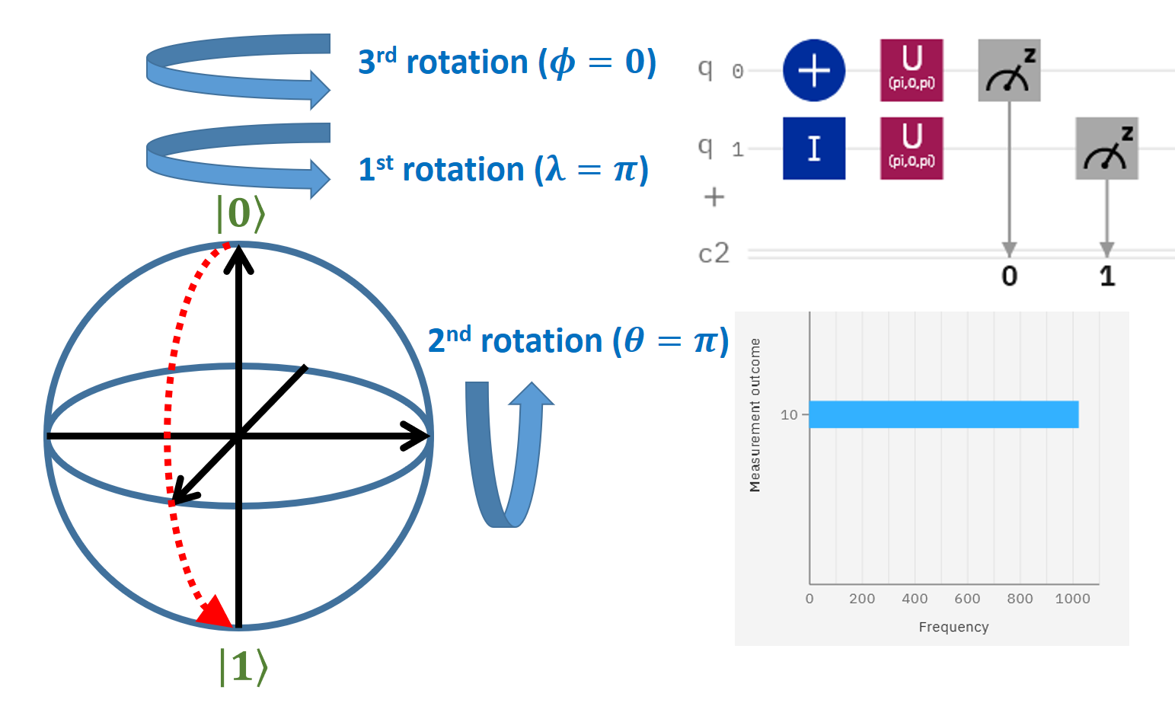

Slide 12
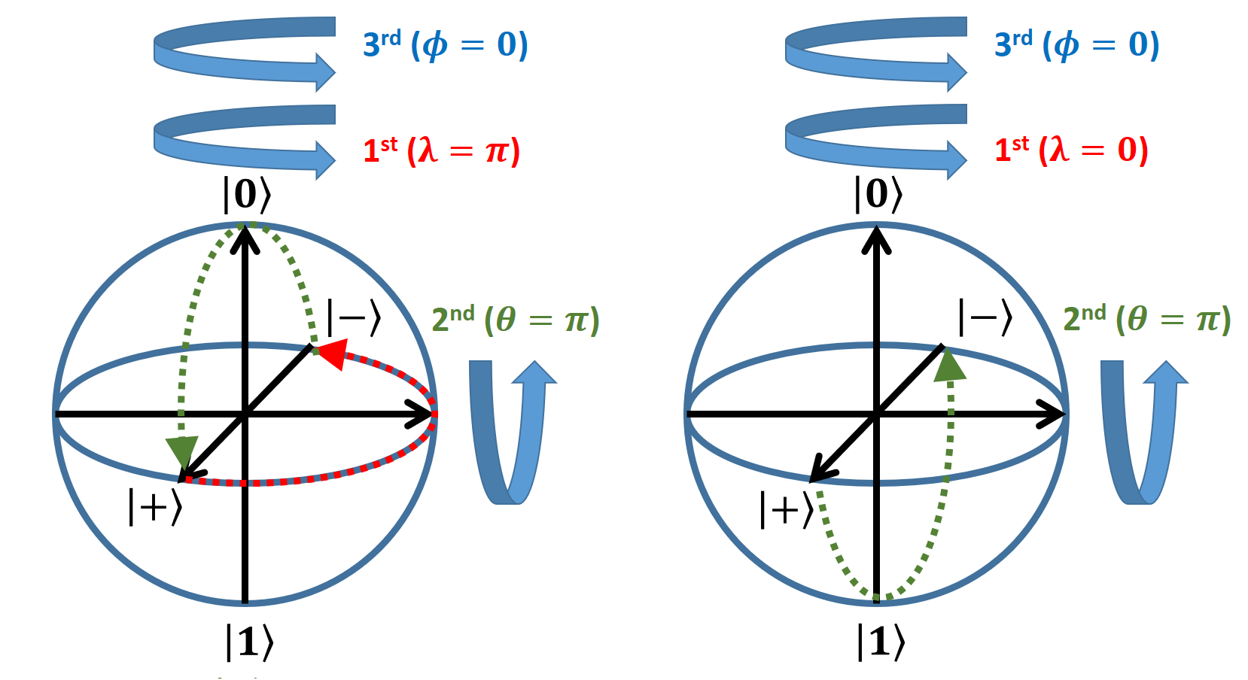
Wrong method to construction rotation matrix Do not use Bloch’s Sphere to construct rotation matrix

